Slide 1

Keeping Safe in School
What to do if you have a worry?

Slide 2
Who can you talk to if you need help
A friend
A teacher
A trusted adult – parents
A TA or MSA
Mrs Clinton or Mrs Thomas

Slide 3
What do we mean by keeping safe?
Bullying
Neglect
Physical abuse
Emotional abuse

Slide 4
Bullying
Bullying is when children are mean and unkind to each other, not just once but again and again. They might push a child around, leave them out, or send nasty texts or emails. This can hurt on the inside or on the outside, and often both.
THIS IS NOT OK!

Slide 5
Neglect
Neglect is when a parent or carer does not look after a child properly. They might not give them enough food and drink, or the right kind of clothing. It can also be when a child is left on their own for too long.
THIS IS NOT OK!

Slide 6
Physical Abuse
Physical abuse is when an adult deliberately hurts a child's body. They might hit, kick, punch, bite or shake them. This may leave marks on the body such as cuts and bruises.
THIS IS NOT OK!

Slide 7
Emotional Abuse
Emotional abuse is when an adult hurts a child's feelings. They might call them names, make fun of them or make a child feel bad about themselves. This hurts children on the inside. Seeing or hearing parents or carers hurting each other can also make a child feel bad.
THIS IS NOT OK!

Slide 8
The PANTs rule
Know the underwear rule. The underwear rule is a simple way to understand how you can stay safe. By learning five easy sayings you can help yourself and others, perhaps a younger brother or sister stay safe.

Slide 9
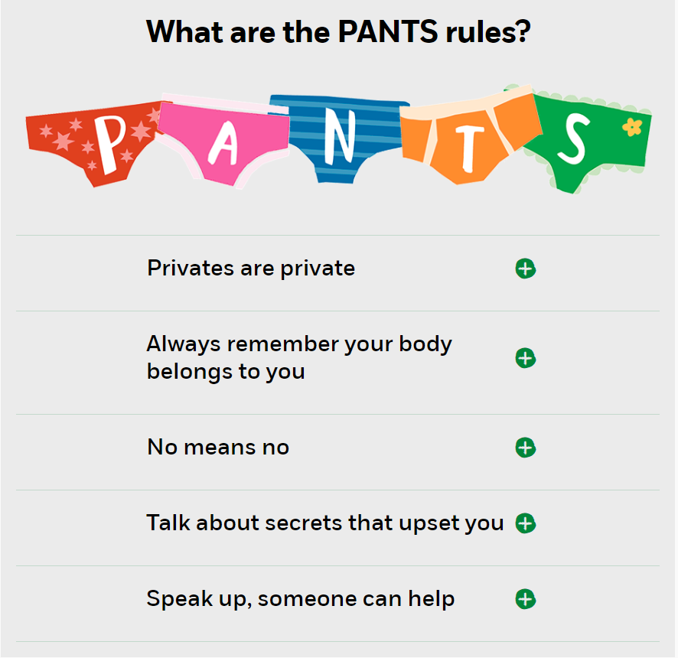

Slide 10
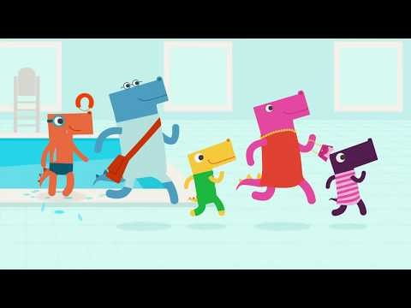

Slide 11
Abuse is never your fault. Someone might say it is, but abuse is NOT OK and it needs to stop.

Slide 12
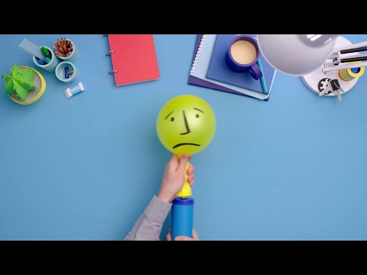

Slide 13
Who can you talk to if you have a worry?
A friend
A teacher
A trusted adult – parents
A TA or MSA
Mrs Clinton or Mrs Thomas
Childline

